Slide 1
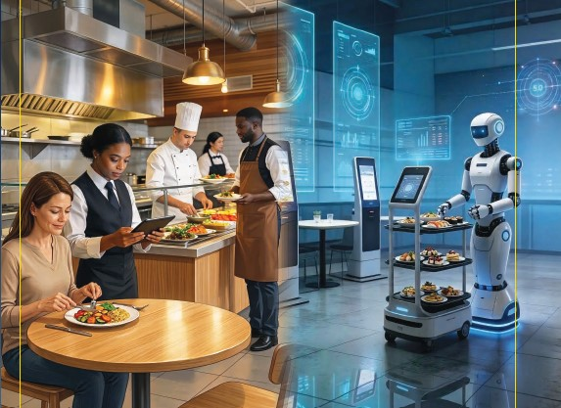

Introduction to the book

Slide 2
Culinary and Food Service Operations Management for Industry 5.0
David Graham is an Associate Head at Sheffield Hallam University within Sheffield Business School, a visiting Research Fellow at the University of Zululand, South Africa and Principal Fellow of Higher Education Academy.
Ewen Crilley is a Senior Lecturer at Sheffield Hallam University and Course Leader for UG and PG Tourism, Hospitality, Culinary and Aviation.
Peter Cox worked in the hotel and contract catering for large international companies. He was a Senior Lecturer at Leeds Beckett University specialising in quality and hospitality operations management.
John Cousins is a consultant, educator, and the author of a range of food and beverage management and service publications, He has been conferred at Culinary Arts Laureate and is Director of the Food and Beverage Training Company.
© 2026 David Graham et al. Culinary and Food Service Operations Management for Industry 5.0. Goodfellow Publishers

Slide 3
Aims of the Book:
Whether used alongside traditional textbooks, or as a standalone foundation, this book aims to help readers develop the tools to lead in the fast changing, dynamic, innovative and global hospitality environment.
This book will help you to:
Gain essential knowledge of the development and impact of Food Service Management 5.0.
Identify how Industry 5.0 serves as a guiding principle for concept development and growth within the food service sector
Evaluate and apply various service concepts, across a range of contemporary challenges, essential to leadership roles in the evolving hospitality industry

Slide 4
Food service / Foodservice
In the UK the word ‘catering’ was often used to refer to all food and beverage operations
The more internationally understood two-word term ‘food service’ has now become the main term used to refer to all food and beverage operations
The one-word term ‘foodservice’ has now become more associated with cost sector and contract catering
This book follows the trend of referring to all food and beverage operations as ‘food service’ operations, and the industry as the ‘food service’ industry

Slide 5
Content
Designed to be a companion text to Food and Beverage management and service books
Intended to develop and push the thinking of food service operators and managers
  Chapters 1 introduces the subject
  Chapters 2 to 4 focus on the traditions of the food service sector, the changes and the impact that these have brought
  Chapters 5 to 8 review the impact of technology, across the breadth of service delivery, future application and the challenge of robotics
  Chapters 9 to 12 review the wider operations management issues, the adoption of quality standards, service improvement and the application of corporate social responsibility within the business

Slide 6
Chapter structure framed by Industry 5.0
Introduction to Culinary and Food Service Operations Management for Industry 5.0.
Changing Nature of Culinary and Food Service Operations
Culinary Production Systems
Food Service Operations and Techniques
Enhanced Food Service Operations in Industry 5.0.
Technological Advancements, Robotics, AI, IOT and Mixed Realities
Social and Cultural Impacts of Technological Integration
Service Redefined, Customer Experience and Personalisation in the Future
Food Service Operations Management
Service Process Improvement
Quality Management Approaches for Food Service
CSR and Sustainable Food Supply Chain Management

Slide 7
Learning support
Each Chapter has:
  Aims and Objectives
  Case Studies
  Learning Activities
  Weblinks
  References and Further Reading
These are supported by:
  Glossary of Terms
  Index
PowerPoint presentations for each chapter are available from the publisher's website

Slide 8
Note on PowerPoint Presentations
PowerPoint presentations are provided as companion learning support for tutors and trainers who are using the book.
Designed to provide a base for tutors to edit to fit their teaching and leaning programme.
The presentations are copyright and may only be used or adapted as long as the source is properly acknowledged.
No permission has ever been given for the presentations to be published anywhere else, or to be posted online.

Slide 9
End of Introduction to the book presentation

Slide 10
Culinary and Food Service Operations Management for Industry 5.0
David Graham is an Associate Head at Sheffield Hallam University within Sheffield Business School, a visiting Research Fellow at the University of Zululand, South Africa and Principal Fellow of Higher Education Academy.
Ewen Crilley is a Senior Lecturer at Sheffield Hallam University and Course Leader for UG and PG Tourism, Hospitality, Culinary and Aviation.
Peter Cox worked in the hotel and contract catering for large international companies. He was a Senior Lecturer at Leeds Beckett University specialising in quality and hospitality operations management.
John Cousins is a consultant, educator, and the author of a range of food and beverage management and service publications, He had been conferred at Culinary Arts Laureate and is Director of the Food and Beverage Training Company.
© 2026 David Graham et al. Culinary and Food Service Operations Management for Industry 5.0 Goodfellow Publishers

